Slide 1







HDS Big Data and Social
Innovation Strategy
<Name>, <title>
<date>
CONFIDENTIAL – For use by Hitachi Data Systems employees and other audiences under NDA only.

Slide 2














The Analytics and Data Revolution
Bigger and Better Insight Drives Bigger and Better Outcomes
Things
Machines, industrial
infrastructure, mobile..
Human
Customers, employees..
DATA EVOLUTION
Transaction
Business Applications
ANALYTICS EVOLUTION
?
TX
TX
TX
THE PAST
WHAT HAPPENED ?
BI AND REPORTING
THE PRESENT
WHAT’S HAPPENING NOW ?
REAL TIME
THE FUTURE
WHAT WILL HAPPEN ?
PREDICTIVE
CONTROL FUTURE
WHAT SHOULD WE DO ?
PRESCRIPTIVE

Slide 3











The Internet of Things
The New Industrial Revolution
Billions (units)
50
42%
of all data generated
from machines
50
Billion
Connected Things
40
30
20
25
10
0
12.5
2010
Pervasive Connectivity Intelligent Machines Machine Generated Data
Predictive & Prescriptive Analytics
2015
2020
Evolution of the Internet
Sources: Cisco 2011, IDC

Slide 4



Making a Difference, a Big Difference
Integrating IT and Infrastructure Technologies for a Safer, More Secure World
Social Innovation Business
The Internet of Things That Matter

Slide 5
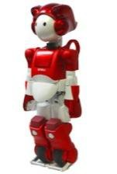

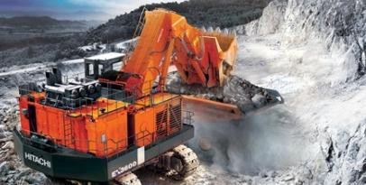

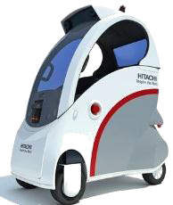
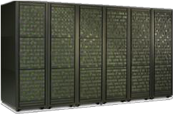







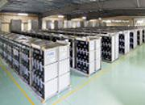
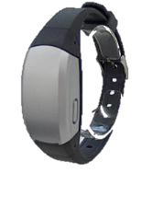

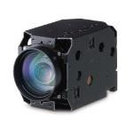

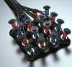











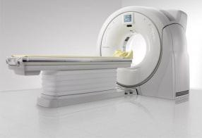

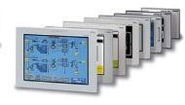
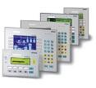
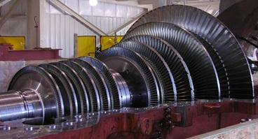




The Internet of Things that Matter
Machine data is in our DNA. We think like users.
ROBOTICS
IT INFRASTRUCTURE
AUTOMOTIVE SYSTEMS
MINING EQUIPMENT
RAILWAY CONTROL SYSTEMS AND TRAINS
BATTERY SYSTEMS
WEARABLES
Machine Data
WATER TREATMENT
SENSORS
WIND
TURBINES
MEDICAL
IMAGING
TX
Data
Human Data
GAS TURBINES
PROGRAMMABLE CONTROLS
Achieving Social Innovation Through Big Data

Slide 6






Hitachi: Breadth Sets Us Apart
Machine data is in our DNA. We think like users
INNOVATE WITH INFORMATION
Information Infrastructure Innovation
Analytics
Innovation
Social
Innovation
and software
infrastructure
to capture, manage, and analyze Big Data
We have the deep domain expertise to turn Big Data into big value
We build the machines and social infrastructure that generate Big Data
ONE HITACHI

Slide 7













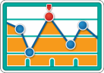










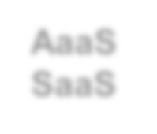















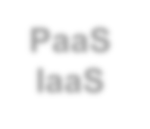




Hitachi Data Systems Strategy
From Information Infrastructure to Big Data Solutions
MACHINE 2 MACHINE UNSTRUCTURED DATA SENSORS STREAM DATA
HYBRID ANALYTICS …
CLOUD
TELECOM
HEALTHCARE
IT
SURVEILLANCE
OIL & GAS
AUTOMOTIVE
INFORMATION
INTELLIGENCE
Aggregate
Identify
Analyze
CONTENT
MANAGEMENT
Mobilize
Protect
Archive
Search
CONTINUOUS
INFRASTRUCTURE
Consolidate
Virtualize
Scale
Automate
Converge

Slide 8


















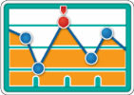



































HDS Is Creating Repeatable Solutions
That Drive Business and Social Outcomes
TELCO
Real-Time Analytics HAKAI
HEALTHCARE
Clinical Data Exchange HCR
MACHINE-TO- MACHINE
Analytics
ANACONDA
PUBLIC SAFETY
Connected Intelligence HDVS
OIL & GAS
Upstream Solutions
AUTOMOTIVE
Connected Car
SILVERSTONE
AQUA: Common Advanced Analytics Platform
Ingest Data
Store, Manage Analysis and Results and
Search Data Forecast Outcomes
CONFIDENTIAL – For use by Hitachi Data Systems employees and other audiences under NDA only.

Slide 9

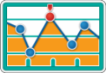












HDS Social Innovation: Delivering Market Leading Solutions
CONFIDENTIAL – For use by Hitachi Data Systems employees and other audiences under NDA only.
Our Proven Approach:
Market-in development with R&D, Engineering, customers, and partners
First-of-a-Kind approach enables rapid delivery of robust and repeatable solutions
End-to-end global market delivery with services and support
M2M
Healthcare
Surveillance
Automotive
Telecom
Oil & Gas

Slide 10












Hitachi Data Science Expertise
CREATE INNOVATIVE BIG DATA & ADVANCED ANALYTIC SOLUTIONS
Sensor and Event Analytics
Stream Platform
Cloud Technology In-Memory
Structured and
Machine Learning
Correlation
Prediction
Scale-out
Optimization
Unstructured Data
Real-time and
historical data
Industry Solutions
ANALYTICS SOLUTIONS TECHNOLOGIES
BIG DATA PLATFORM TECHNOLOGIES
Big Data Lab

Slide 11







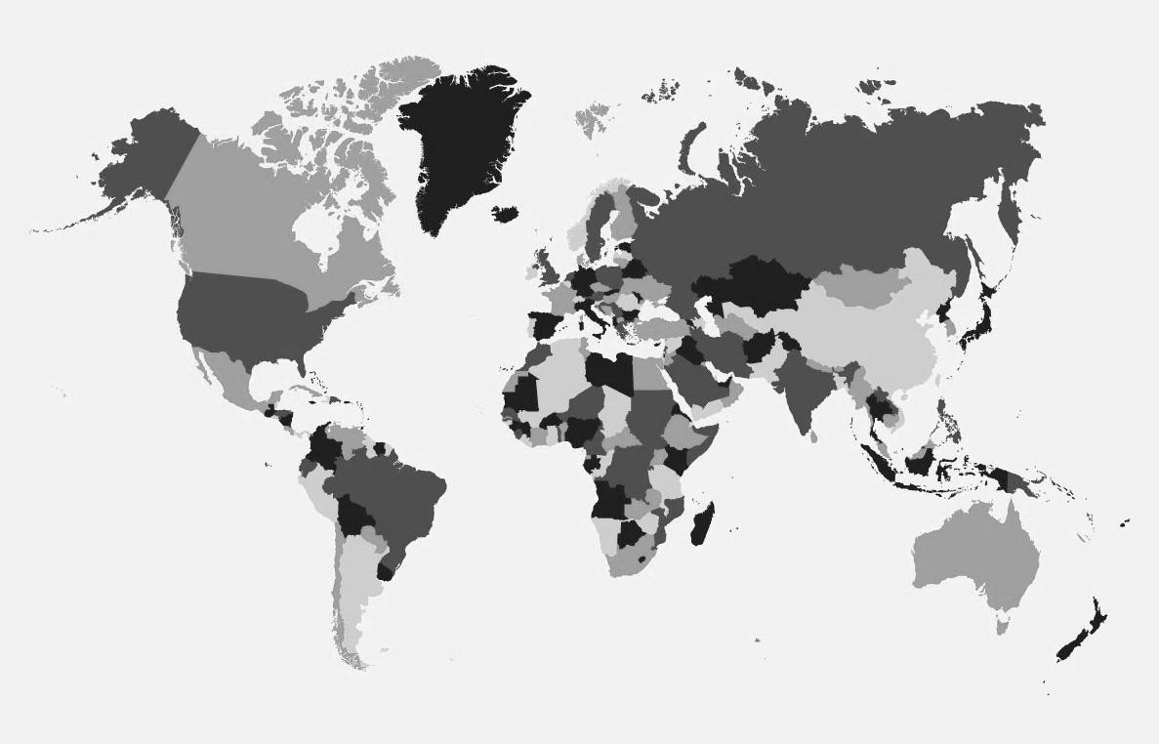






Hitachi Global Centers for Analytic Innovation
DENMARK
Energy Efficiency Digitalization Smart Mobility
INDIA
Energy Transportation Analytics Framework
CHINA
Transportation Energy Healthcare
UK / FRANCE
Healthcare Automotive
JAPAN
Mining Transportation Energy Healthcare Automotive Analytics Framework
USA
Energy Oil & Gas Mining
IT Analytics CME
Automotive Analytics Framework
SINGAPORE
CME
Oil & Gas Transportation Energy Healthcare

Slide 12



























Evolving Analytics Architecture
Foundation for Social Innovation Solutions
SOLUTIONS (HITACHI, GLOBAL SYSTEMS INTEGRATORS AND
PARTNERS)
SERVICES
SMART INGEST
Data capture Stream processing Event extraction Data enrichment
VISUALIZATION AND INSIGHTS
PRESENTATION AND ACTION
Event detection: predictive and prescriptive control Search, diagnosis, correlation and root-cause analysis
BULK INGEST
Capture and index
ANALYSIS AND COMPUTE
Real-time analytics, batch analytics, hybrid analytics Machine learning, NLP, voice/image/video
Tx
METADATA MGT
Continuous extraction Unstructured, semi-structured Domain specific
DATA STORAGE AND MANAGEMENT
Specialized data stores Optimized infrastructure In-memory, federated, scale-out, distributed
DATA SOURCES
Deep Domain Expertise
Curated architecture integrating Hitachi, Open Source and partner IP.
Open and flexible. Cloud and on-premise deployment.
Promotes reuse and best-practice repeatability.
Reduces application complexity to speed time to market.
1

Slide 13



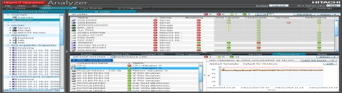
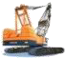

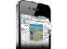
HSDP
Hitachi Streaming Data Platform
REAL TIME ANALYSIS AND DECISION MAKING
INPUT
Big Data
OUTPUT
Actionable info at the right time
Real time analysis on arrival
Sources
Correlation , Pattern Matching
Predictive Analytics Change Detection
Stock feed
IT operation log
Geo location
Mobile comm.
Sensor data
RFID, IC, POS
Algorithmic trading
IT system monitoring
Intelligent transportation
Location based services
Proactive maintenance
Supply chain management
Real Time Analytic
Window

Slide 14
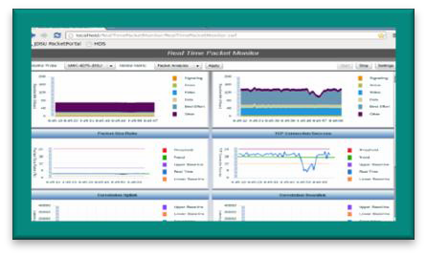

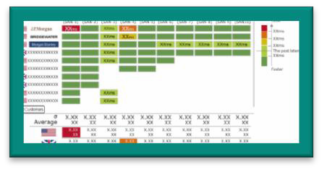
Network Analytics for CME
IN PARTNERSHIP WITH JDSU, HITACHI CONSULTING, HITACHI TELECOM DIVISION AND HGC-IA
BUSINESS OBJECTIVES
Telecom Infrastructure is a massive capital and operational expense
Billions is spent annually on CAPEX alone
Optimization delivers huge ROI and improved customer experience
SOLUTION
Ingest real time network data from highly granular probes
Combine trend analysis, machine learning and real time analytics to provide instant consumable insight
Deliver deep network visibility, dynamic optimization and proactive intervention
14

Slide 15
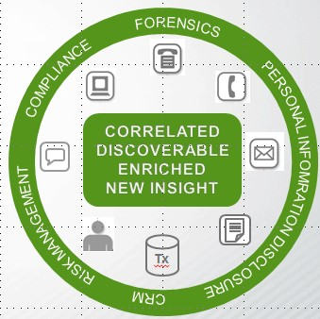




Unstructured content: untapped insight BIG opportunity
CONSOLIDATING CONTENT SILOS IS THE FIRST STEP TO INSIGHT
STRUCTURED DATA UNSTRUCTURED DATA
ANALYZED
DARK
DARK
ANALYZED
> 80% of data unstructured
< 0.5% analyzed today
20%+ could hide insight (IDC)
< 20% of data structured
Most analyzed today
Example: Customer
Communications Consolidation
Foundation for insight
DATA WAREHOUSE
Foundation for insight
HDS INFORMATION CLOUD
UNSTRUCTURED CONTENT IS THE UNTAPPED OPPORTUNITY

Slide 16
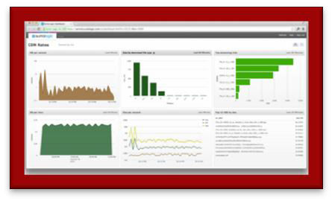

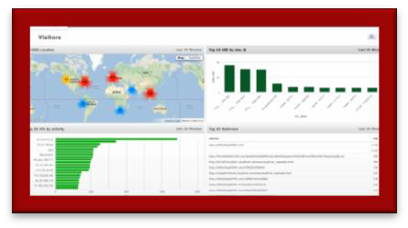
Data Center Analytics
INITIAL AVAILABILITY SUMMER
BUSINESS OBJECTIVES
Transform Data Center data into meaningful insights
Predictive device failure
Root cause analysis
Anomaly detection
SOLUTION
Real-time streaming data sources collected and analyzed
Correlates multi-channel data sources
Predict events before they happen and take action on the data
Provides real-time operational intelligence from any IT device- generating systems logs
Partner-based data center analytics software deployed by HDS on Hitachi compute blades, managed by HDS

Slide 17
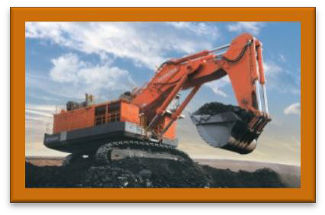
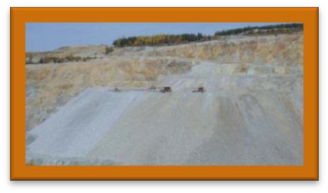
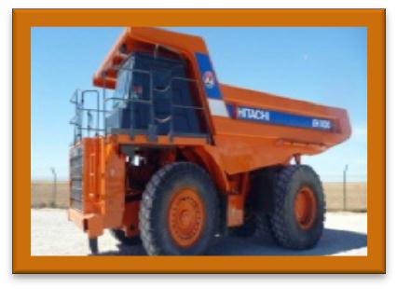
Mining Operations Optimization
Under Development
HITACHI CONSTRUCTION, WENCO, HGC-IA, HCC, HDS
BUSINESS OBJECTIVES
Better operational insight
Reduction in non-productive time via dispatching
Predictive maintenance
UNDER DEVELOPMENT
Mining operations simulations leveraging machine learning driving new dispatch algorithms
Predictive maintenance algorithms
Operational dashboard
Solution architecture
17

Slide 18
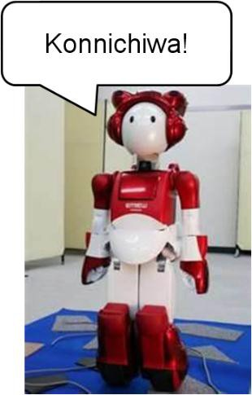
BIG DATA LABS in JAPAN
Hitachi’s Big Data Powered Robot
Service robot with diverse communication functions to safely co-exist with humans
Sensors are her senses!
Visual object recognition and location using Hitachi developed similar image recognition technology
Voice recognition in noisy environments
Sensor driven suspension for uneven terrain

Slide 19
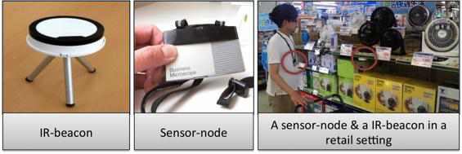
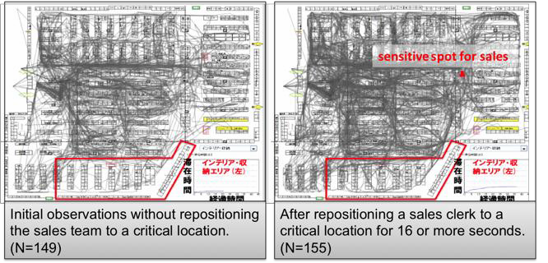
Business Microscope
HUMAN BEHAVIOR TRACKING
Tracking human behavior with wearable sensors
Used in a home improvement store to optimize sales staff to drive customer traffic to high value areas
A second project tracked Call Center staff behavior to identify correlations with sales performance
Insight increased productivity
Insight resulted in increased
revenue

Slide 20



The Future of Big Data – A United Hitachi View
Integrating IT and Infrastructure Technologies for a Safer, More Secure World
Social Innovation Business
When Information Technology Meets Operational Technology
Innovation Happens!

Slide 21

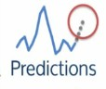
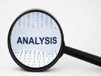




Hitachi Scale Out Platform
Target GA Q1 CY15
Converged Compute and Storage solution
Distributed scale out appliance optimized for
– Hadoop, Analytics and Openstack
Pre-built analytics apps and solutions for targeted verticals.
Hadoop APIs to build analytics apps.
Scale out converged platform, ideal for private compute clouds.
Scale Out

